Slide 1
Data Exploration and Analysis Project
Dat Dao

Slide 2
Variables
Dataset from a specific American city and property attributes to create a model that precisely forecasts house prices.
Id | int64 | GrLivArea | int64
MSSubClass | int64 | BsmtFullBath | int64
Neighborhood | object | BsmtHalfBath | int64
Condition1 | object | FullBath | int64
BldgType | object | HalfBath | int64
HouseStyle | object | TotalBath | float64
OverallQual | int64 | BedroomAbvGr | int64
OverallCond | int64 | GarageCars | int64
YearBuilt | int64 | YrSold | int64
YearRemodAdd | int64 | SalePrice | float64

Slide 3
Description of Variables
Id: unique identifier for each house
MSSubClass: Identifies the type of dwelling involved in the sale (e.g. 1-story, 2-story, etc.)
Neighborhood: Physical locations within Ames city limits (e.g. Blmngtn, BrDale, etc.)
Condition1: Proximity to various conditions (e.g. adjacent to a feeder street, near an arterial road, etc.)
BldgType: Type of dwelling (e.g. single-family detached, townhouse end unit, etc.)
HouseStyle: Style of dwelling (e.g. 1-story, 2-story, etc.)
OverallQual: Rates the overall material and finish of the house (1 = Very Poor, 10 = Very Excellent)
OverallCond: Rates the overall condition of the house (1 = Very Poor, 10 = Very Excellent)
YearBuilt: Original construction date
YearRemodAdd: Remodel date (same as construction date if no remodeling or additions)
GrLivArea: Above grade (ground) living area square footage
BsmtFullBath: Basement full bathrooms
BsmtHalfBath: Basement half bathrooms
FullBath: Full bathrooms above grade
HalfBath: Half baths above grade
BedroomAbvGr: Bedrooms above grade (does not include basement bedrooms)
GarageCars: Size of garage in car capacity
YrSold: Year Sold (YYYY)
SalePrice: Sale price of the house in dollars (the target variable)

Slide 4
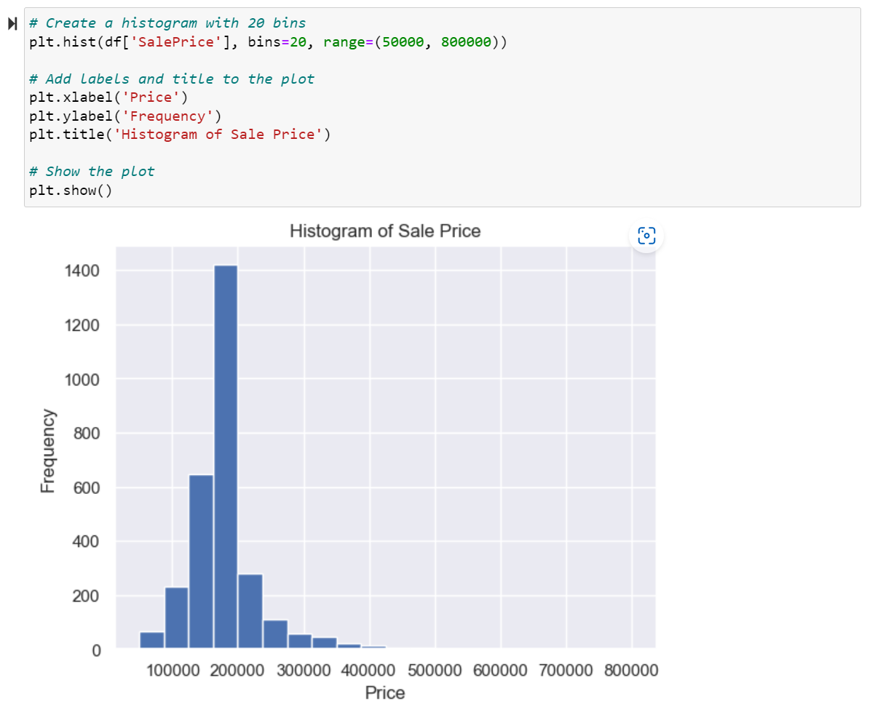
Histogram of Sale Price

Slide 5
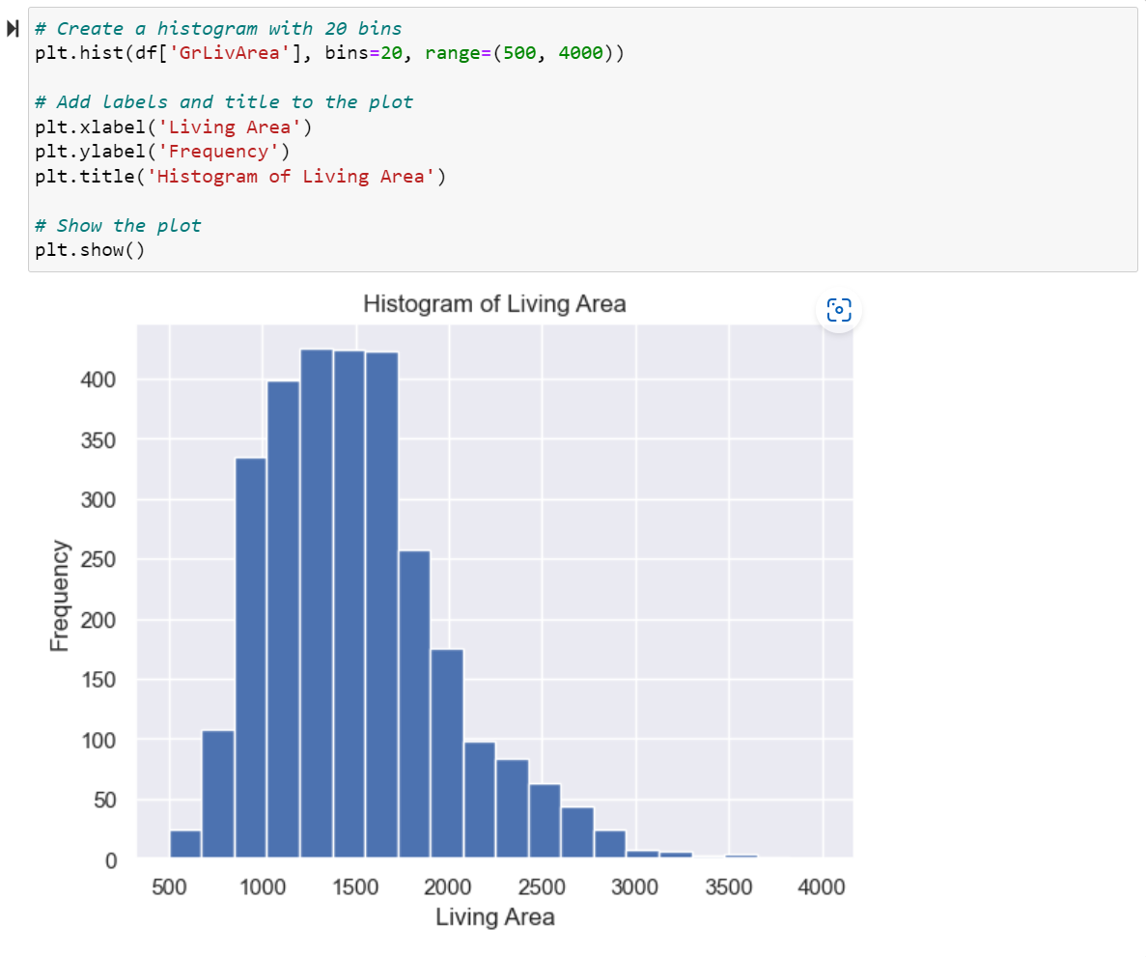
Histogram of Living Area

Slide 6
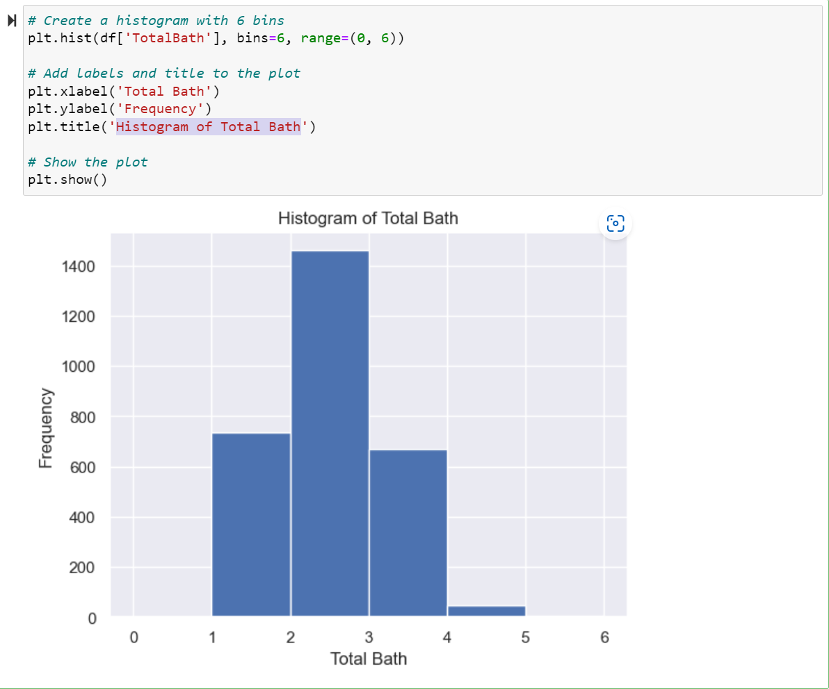
Histogram of Total Bath

Slide 7
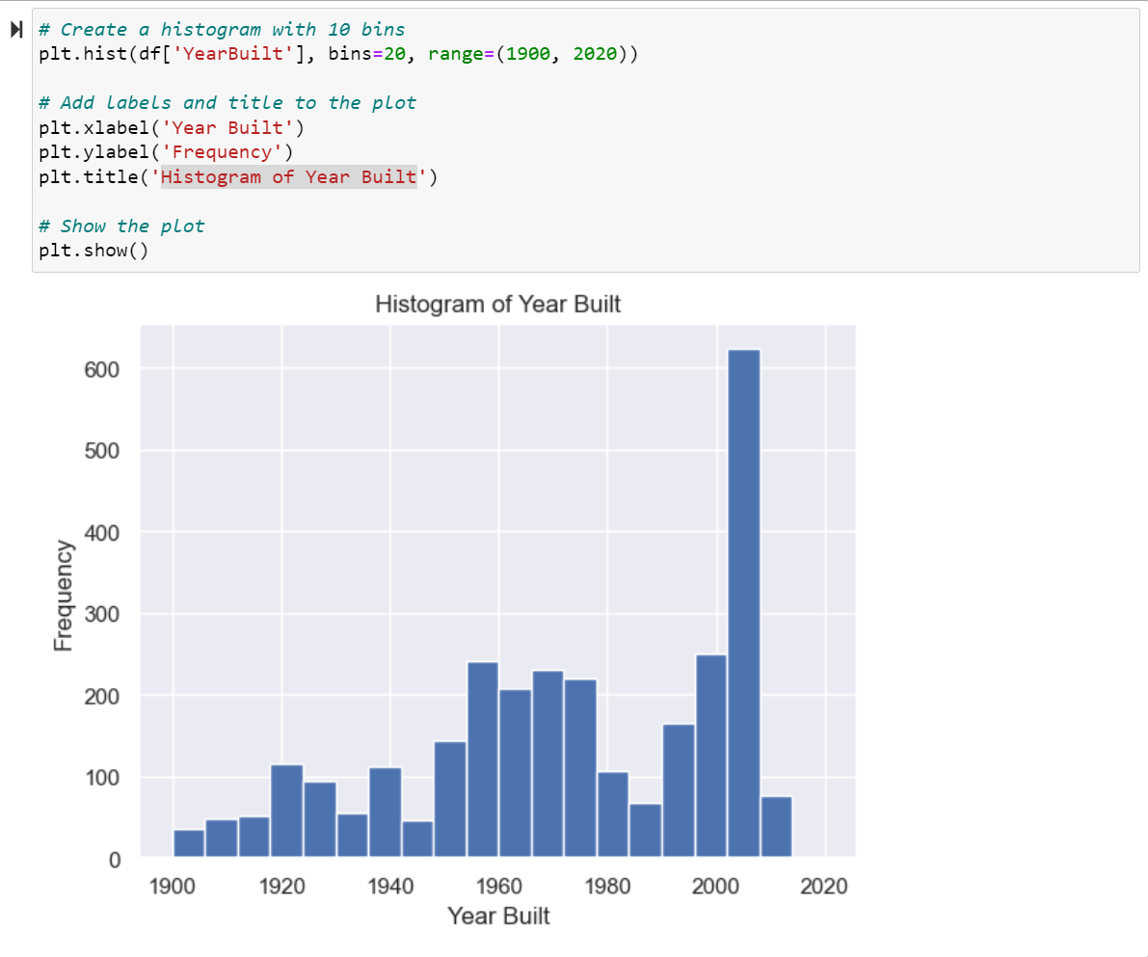
Histogram of Year Built

Slide 8
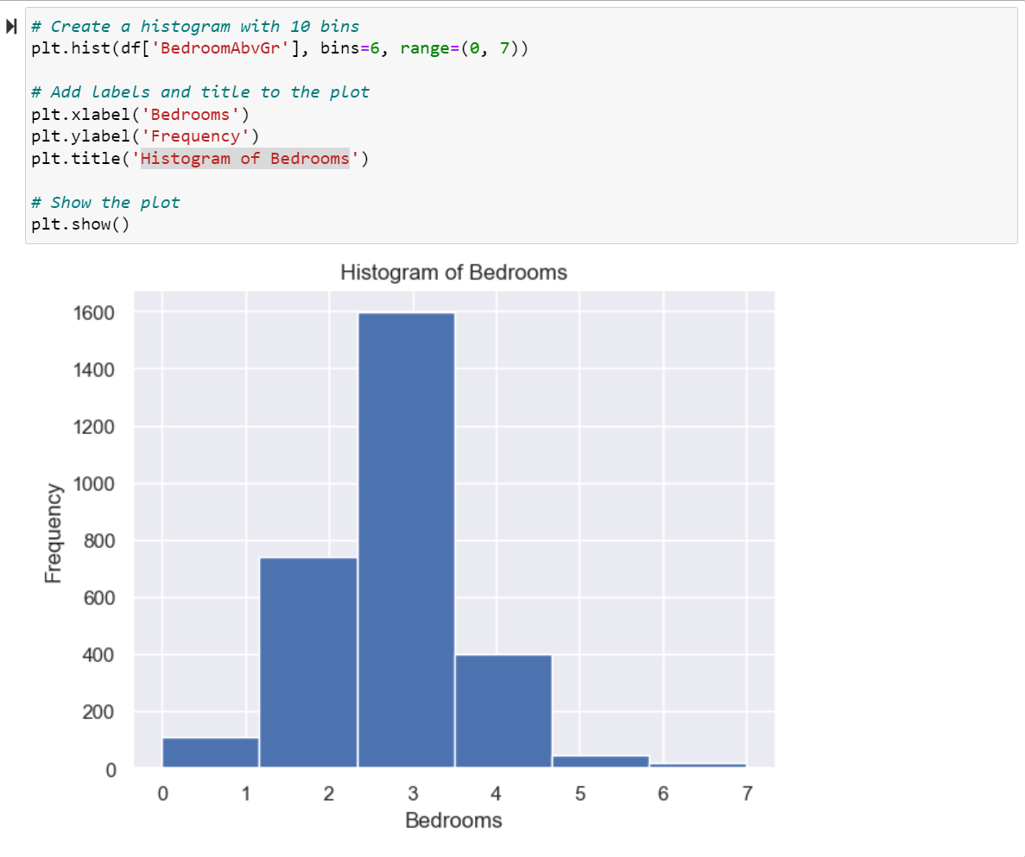
Histogram of Bedrooms

Slide 9
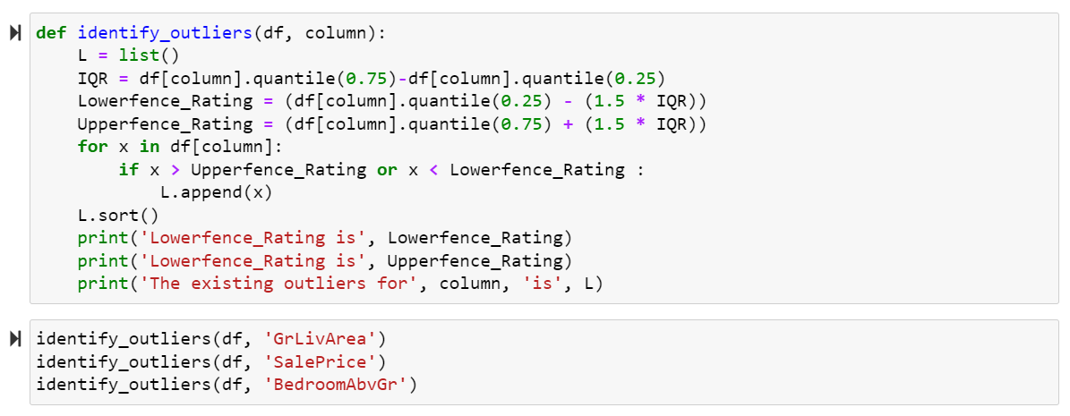
Identifying outliers
To detect outliers, one can calculate the interquartile range and consider values beyond that range as outliers. Values below the lower fence and above the upper fence do not need to be considered. If necessary, outliers can be removed depending on the intended purpose.
Lowerfence_Rating is 199.5 Lowerfence_Rating is 2669.5
Lowerfence_Rating is 98979.08517500001 Lowerfence_Rating is 247637.638775
Lowerfence_Rating is 0.5 Lowerfence_Rating is 4.5

Slide 10
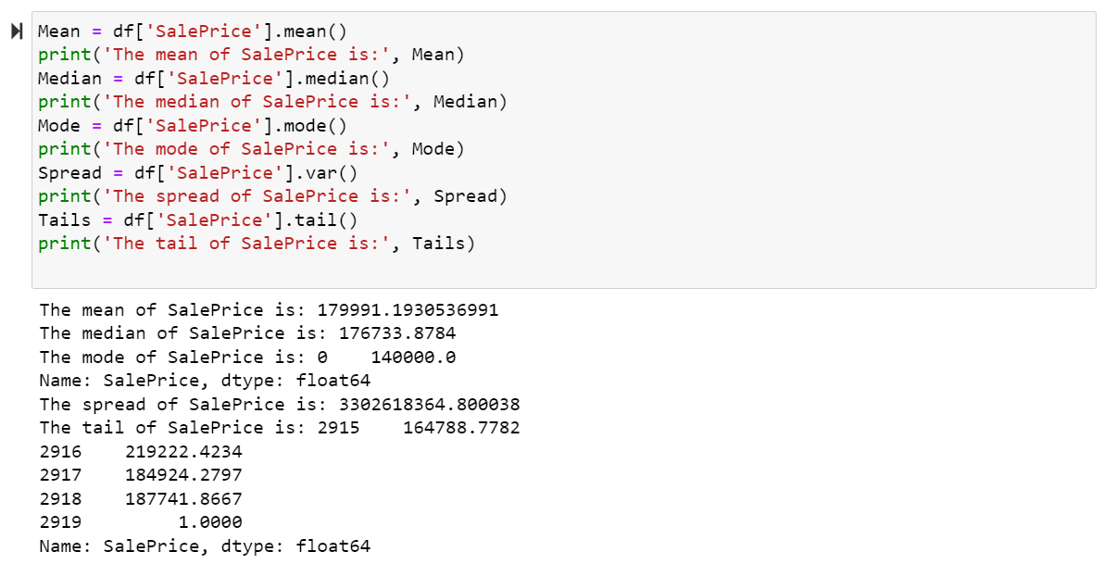
Descriptive characteristics

Slide 11
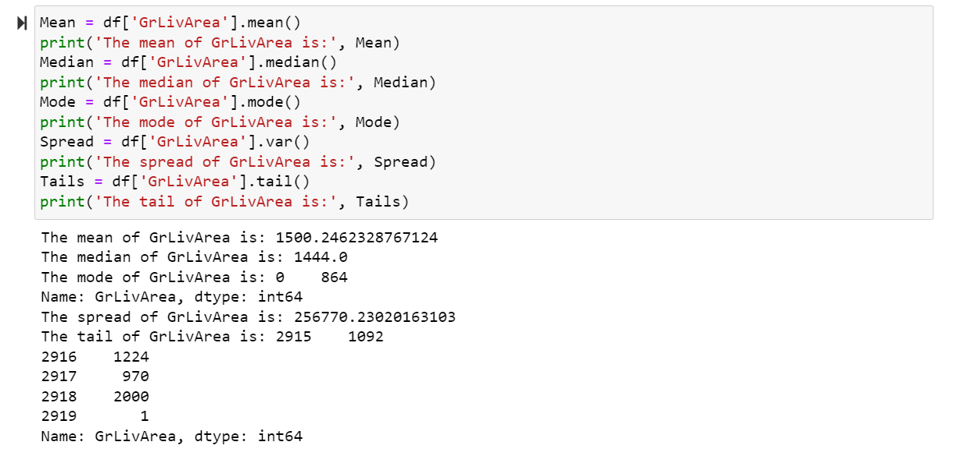

Slide 12
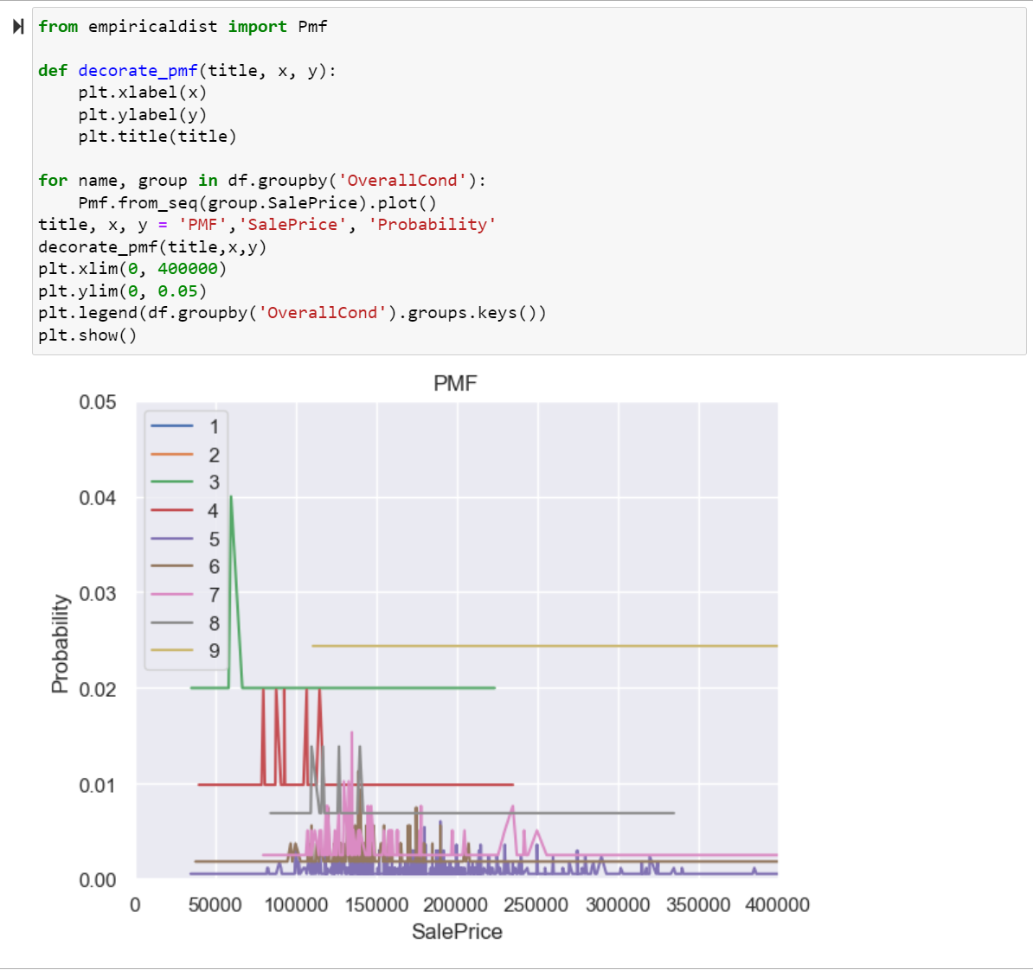
Probability Mass Function (PMF)
There is no difference between the price for conditions 6 and 7. The price for condition 5 is spread out between 100k-200k. Since the price for 6 and 7 conditions is concentrated between 100k-175k. We can see the trend that the condition overall higher seems to be sold at a higher price as the chart shifted to the right more.

Slide 13
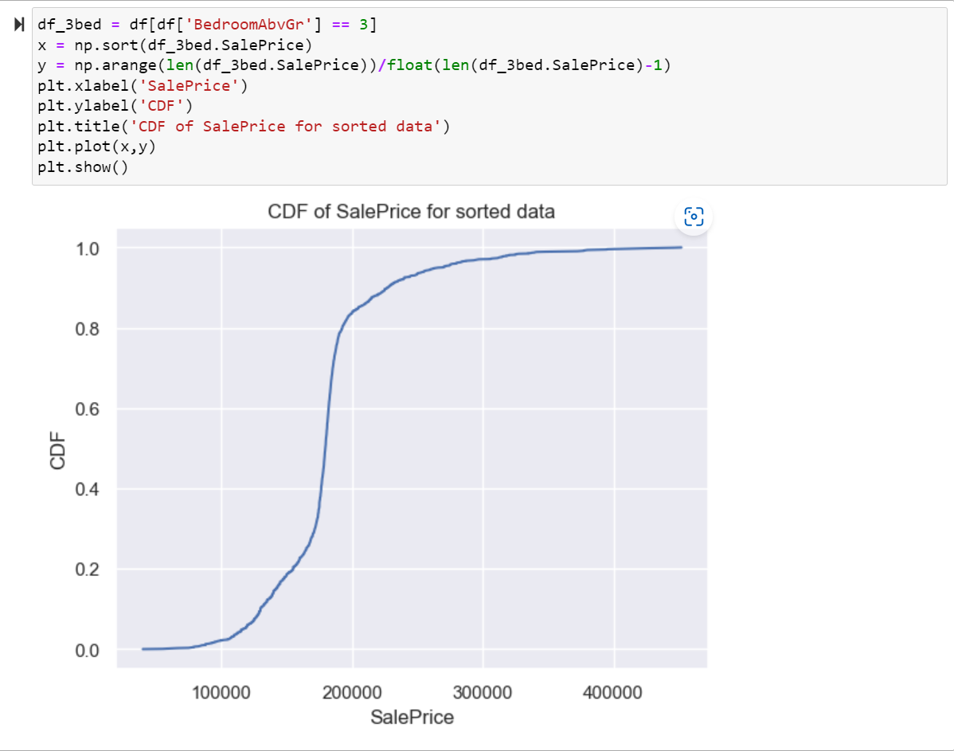
Plotting Cumulative Distribution Function(CDF)
The maximum Price for 3 bedrooms house is approximately 400000 with the probability is 1

Slide 14
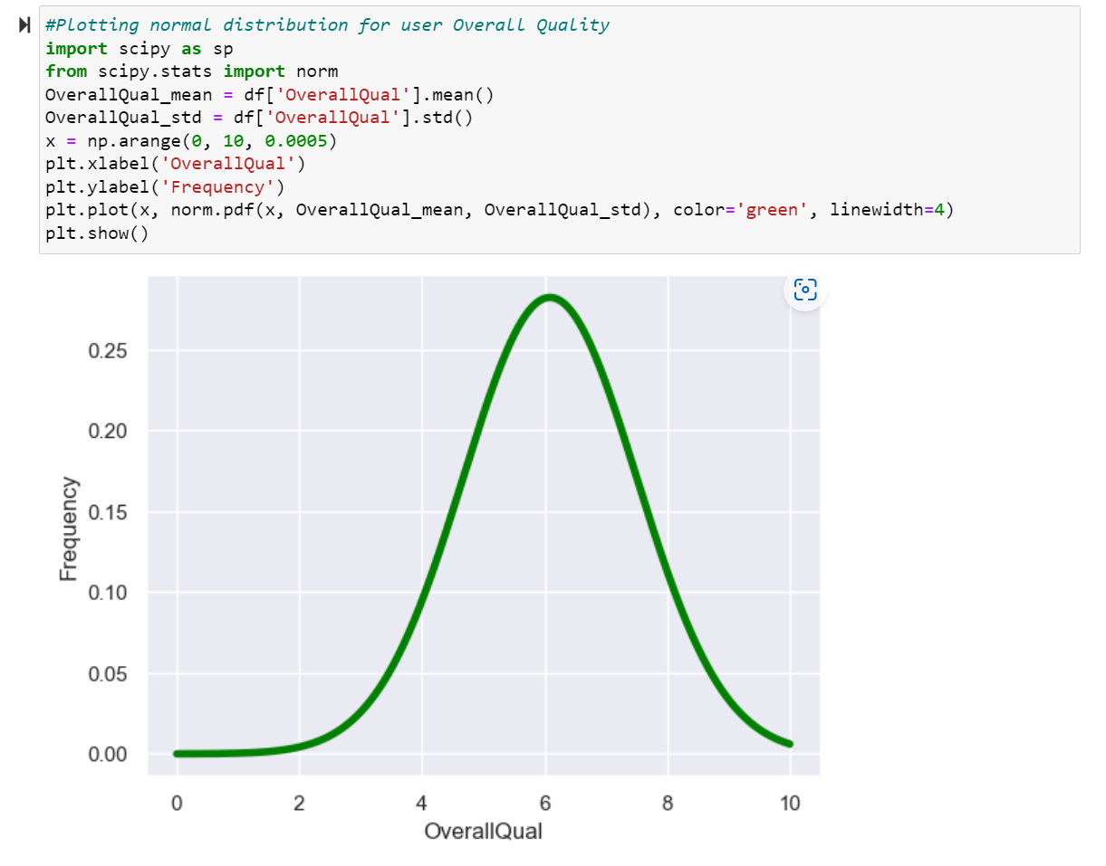
Normal or Gaussian Distribution
The distribution of Overall Quality is a bell-shaped curve, so this follows gaussian distribution.

Slide 15
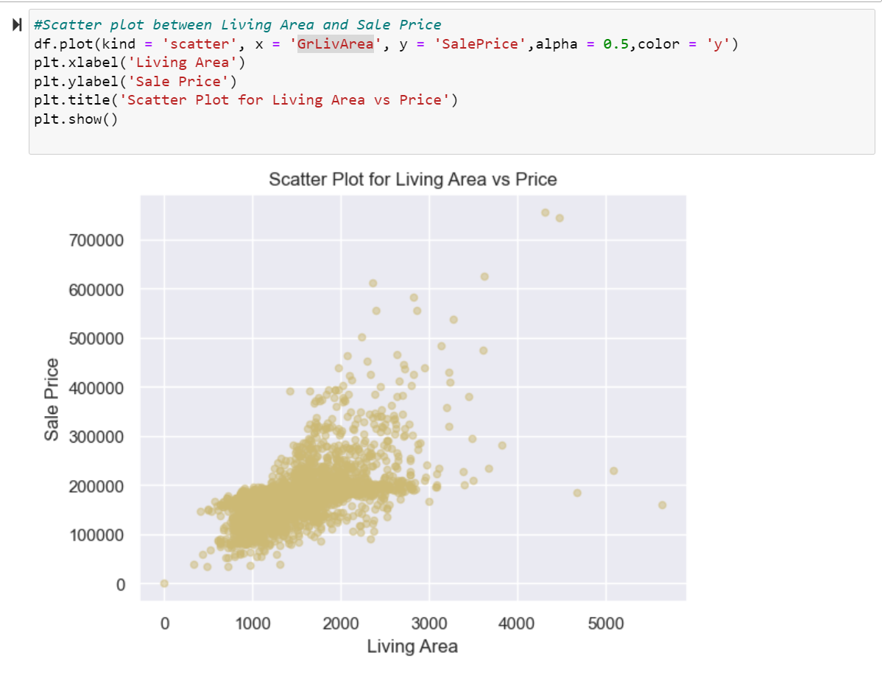
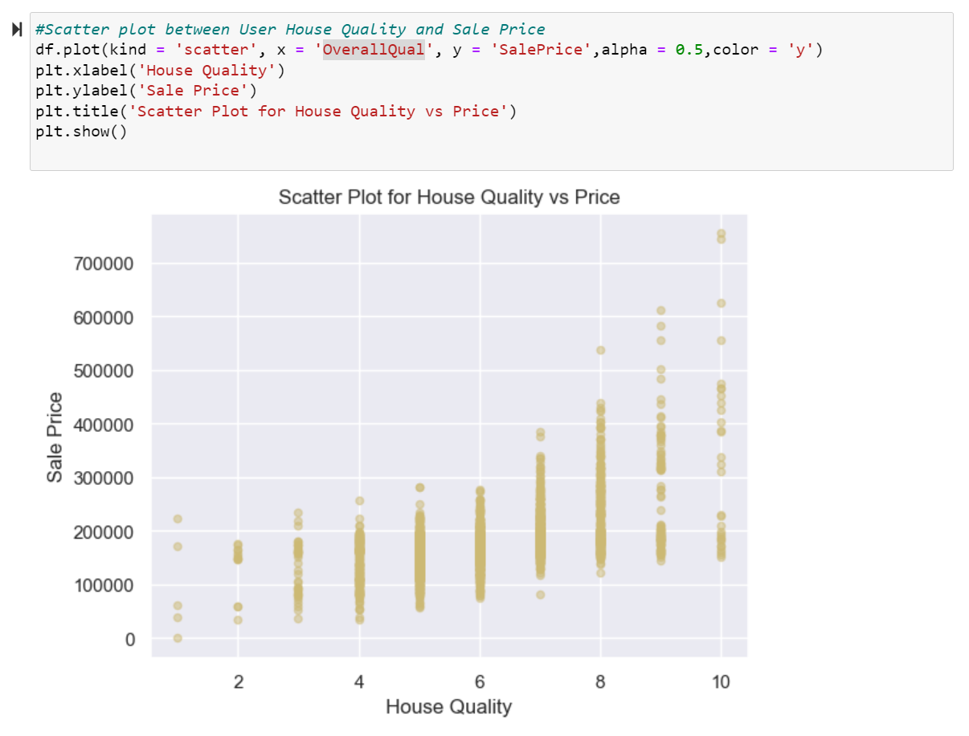
Scatter Plots
Based on the scatter plots, we observe that a majority of the houses were sold for under 300,000 and had an area of under 3,000 sqft. Although there appears to be a trend that larger houses are sold at higher prices, this relationship is not entirely clear since several other factors affect house prices. However, we can deduce that there is a positive correlation between the quality of a house and its sale price. Houses with a higher quality rating are generally sold at higher prices. Specifically, the sale prices for houses with quality ratings of 5, 6, and 7 range from around 80,000 to 350,000 and are relatively consistent.

Slide 16
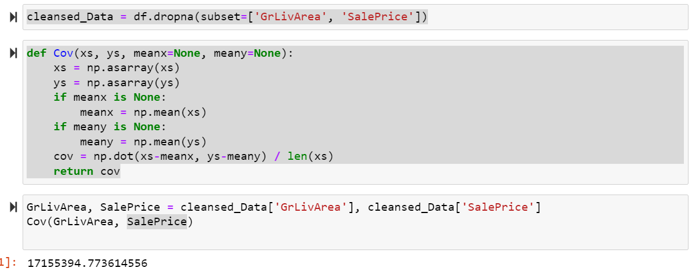
Covariance & Correlation
The Pearson correlation coefficient measures the strength and direction of the linear relationship between two variables. The coefficient between GrLivArea and SalePrice of 0.59 indicates a moderately strong positive relationship. A positive correlation means that as one variable increases, the other tends to increase. In this case, as the living area of a house increases, the sale price tends to increase. A coefficient of 0.59 indicates a moderately strong positive relationship, with some unexplained variability in the data that is not captured by the linear relationship.

Slide 17
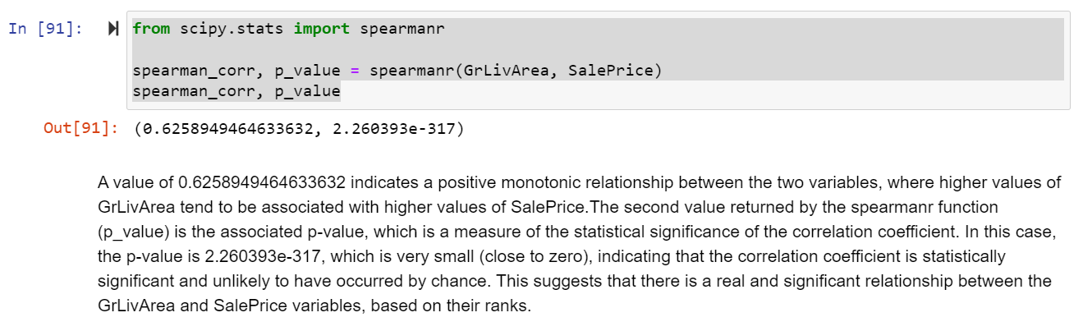

Slide 18
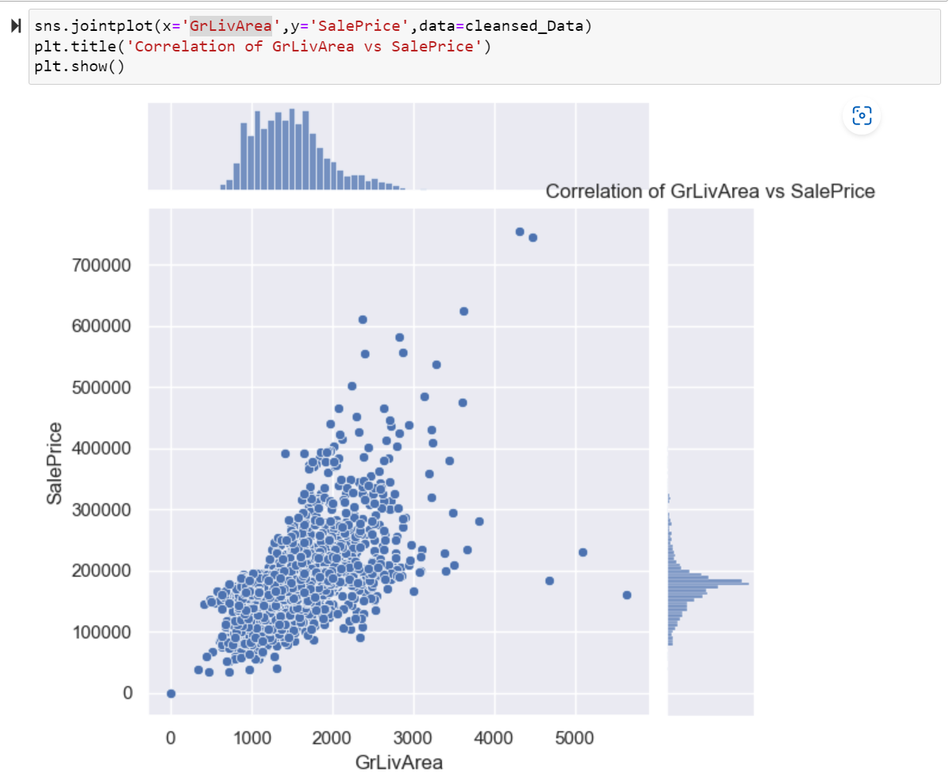
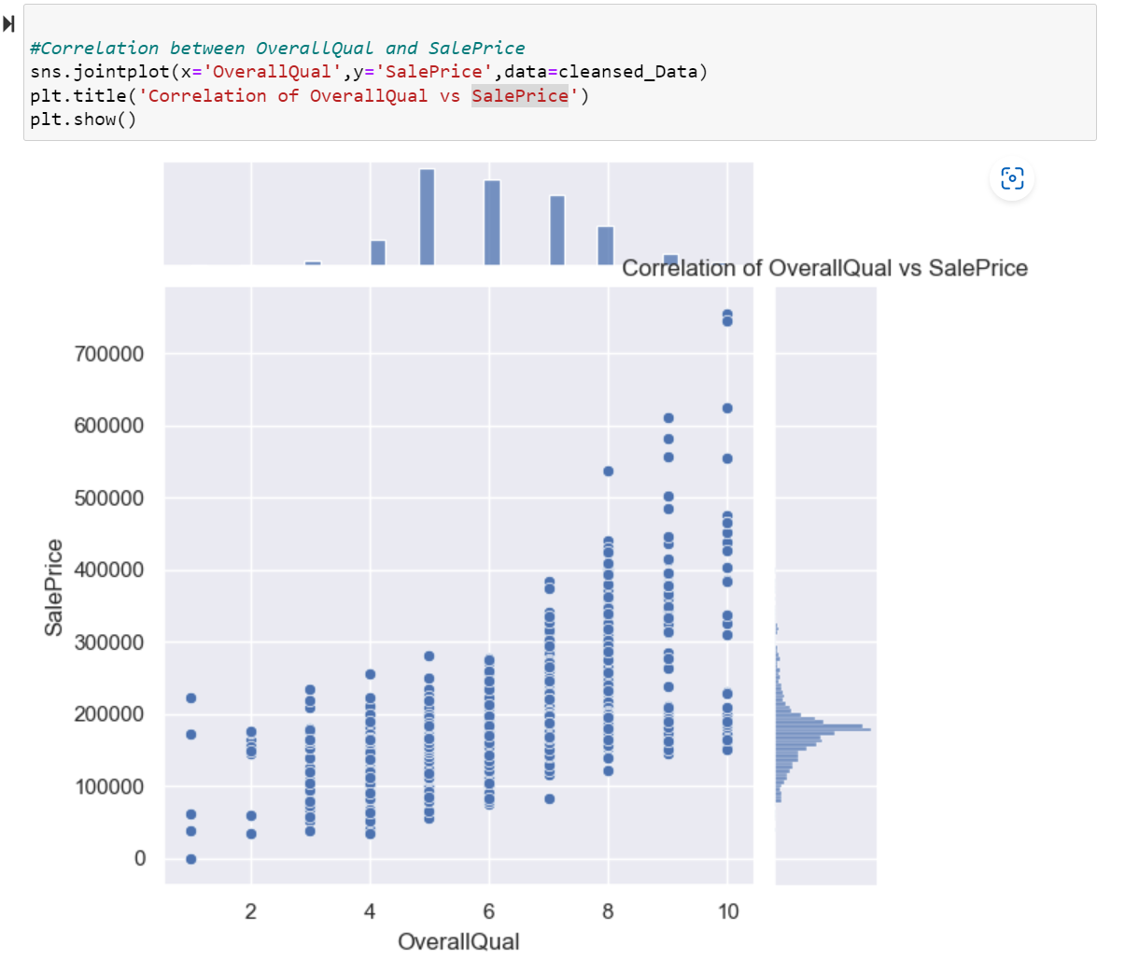
Plotting correlation

Slide 19
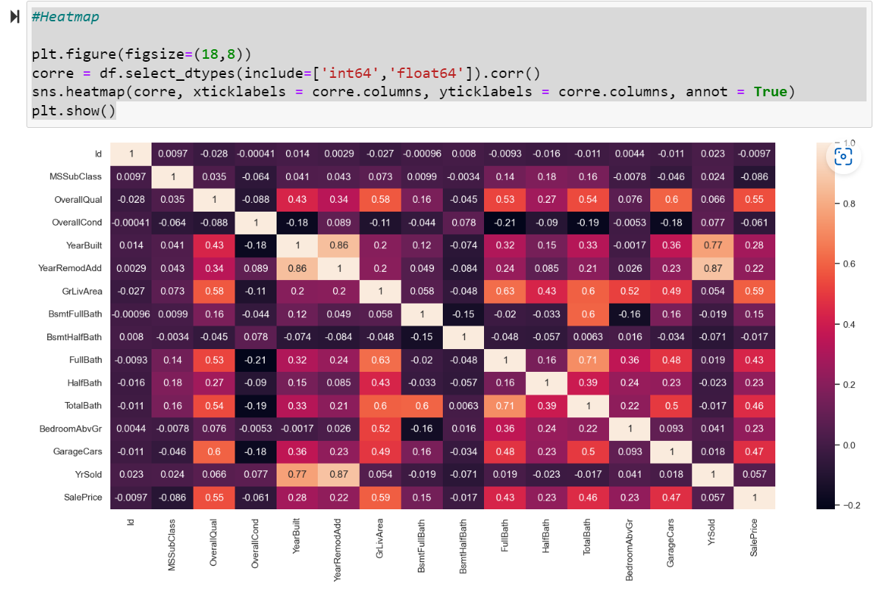
Heatmap

Slide 20
Hypothesis testing
The mean GrLivArea is equal to 1500 square feet. Our null hypothesis would be:
H0: μ = 1500
And our alternative hypothesis would be:
Ha: μ ≠ 1500
The test statistic in this context is a measure of how much the sample data deviates from the null hypothesis, which is a hypothesis that assumes there is no significant difference between the two groups being compared. In this case, the test statistic is 0.026258210735064715.
The p-value is 0.9790513864104508, which is relatively high. This indicates that the observed test statistic is insignificant, and we cannot reject the null hypothesis. This means there is no evidence to suggest a significant difference between the two groups being compared.

Slide 21
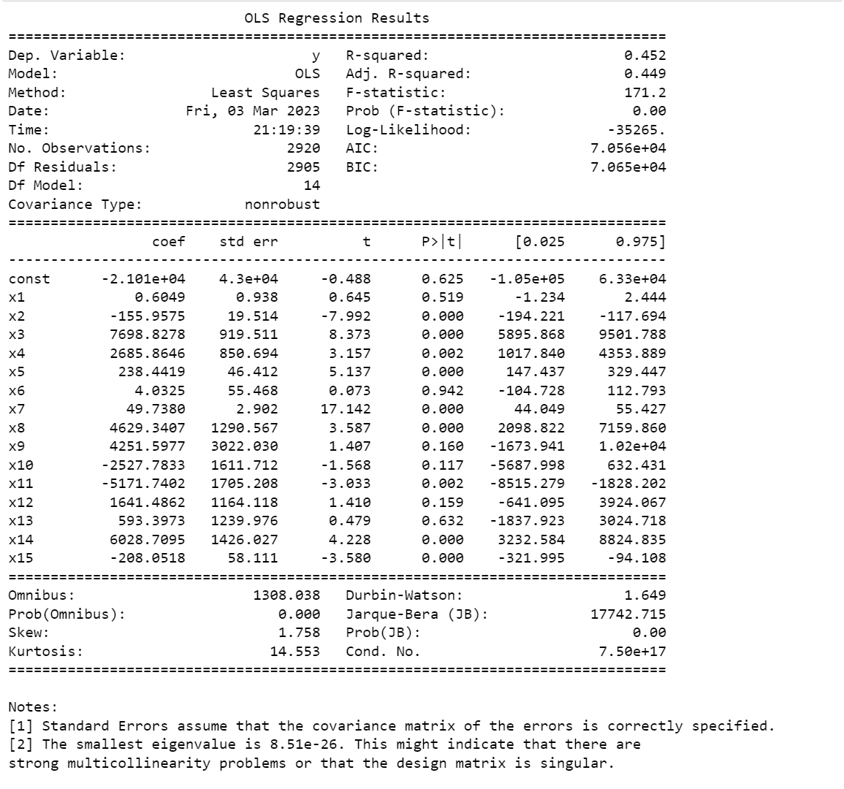
Multiple linear regression
R-squared: This is the coefficient of determination, which measures the proportion of variance in the response variable explained by the predictor variables. In this case, the R-squared value is 0.452, which means that the predictor variables explain 45.2% of the variance in the sale price.
Adj. R-squared: This is the adjusted R-squared value, which takes into account the number of predictor variables in the model. In this case, the adjusted R-squared value is 0.449.
F-statistic: This is the F-statistic for the overall significance of the model. It tests whether the predictor variables as a group significantly affect the response variable. The F-statistic value is 171.2, and the p-value for the F-test is 0.00, which means that the model is statistically significant.
Coefficients: These are the estimated regression coefficients for each predictor variable. The coefficient represents the change in the response variable (sale price) associated with a one-unit increase in the predictor variable, holding all other variables constant. The intercept (const) coefficient is -21010, which means that the predicted sale price when all predictor variables are equal to zero is $21,010. The other coefficients represent the change in the sale price associated with a one-unit increase in each predictor variable.
Standard errors: These are the standard errors of the regression coefficients, which measure the variability of the estimated coefficients. The const coefficient has a t-value of -0.488 and a p-value of 0.625, indicating that it is not statistically significant at the conventional alpha level of 0.05. This means that the intercept term is not significantly different from zero, and the regression line is not significantly different from intersecting the y-axis at zero.

